Slide 1
Scala tips and tricks
  David Pollak
  Silicon Valley Code Camp
  November 9th, 2008

Slide 2
David Pollak
Not strict, but pretty lazy
Lead developer for Lift web framework
Scala since November 2006, Ruby/Rails, Java/J2EE
Spreadsheet junky (writing more than using)

Slide 3
Scala
Fast, Compatible, JVM language
Superset of Java's object model
  Everything that Java's got plus better type system
  100% compatible with Java objects
  Everything is an object
Functional
  Immutable data structures
  Type inferencing
  Super-easy to pass functions as parameters

Slide 4
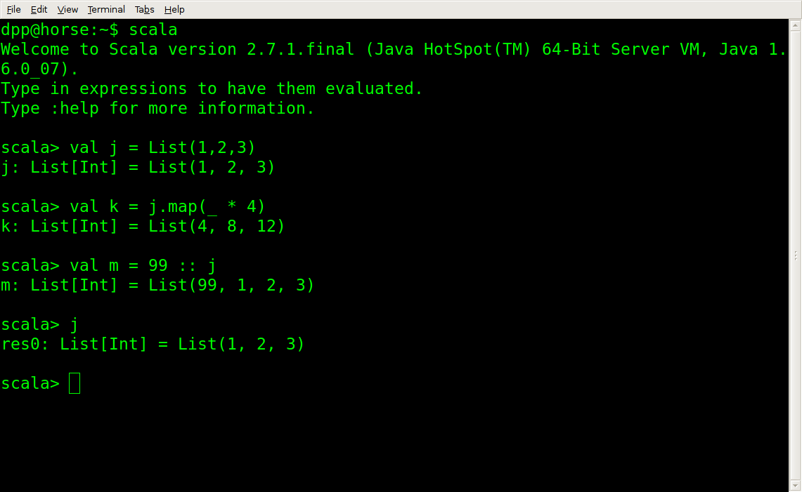
At the command line

Slide 5
Collections
List[T]
  Immutable
  Linked List of type T (String, Int, FooClass)
  Very efficient for small collections
Array[T]
  Mutable
  Thin veneer on JVM Array
  Lots of methods (map, filter, toList, etc.)

Slide 6
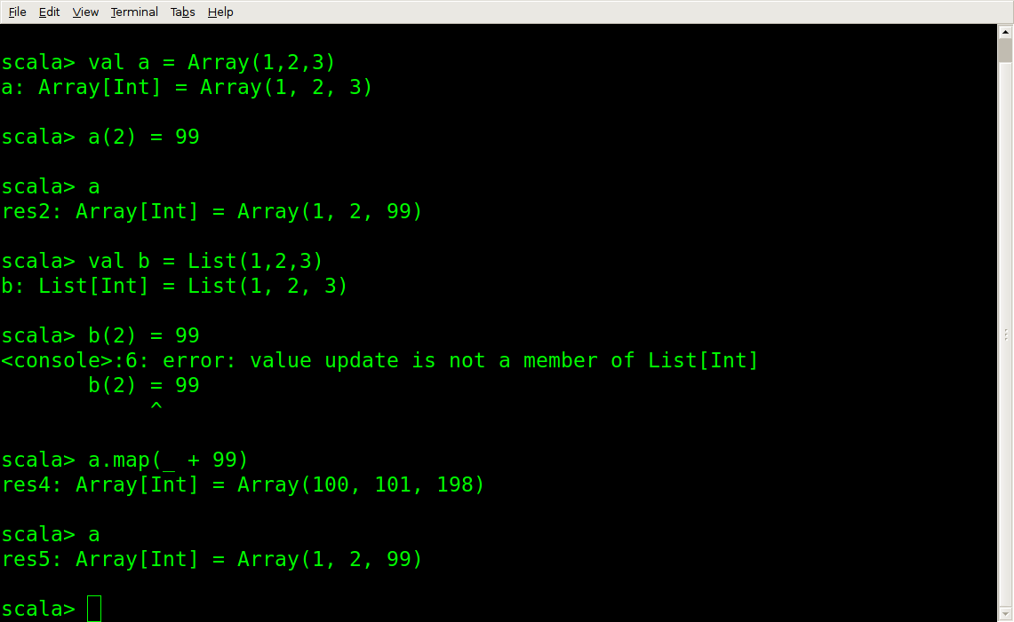
Collections

Slide 7
map & filter
map
  Apply a function to each element in original
  Return a new collection containing the result
  List(1,2,3).map(_ + 1) // List(2,3,4)
filter
  Test each element against a function that returns Boolean
  Return a new collection containing items that passed

Slide 8
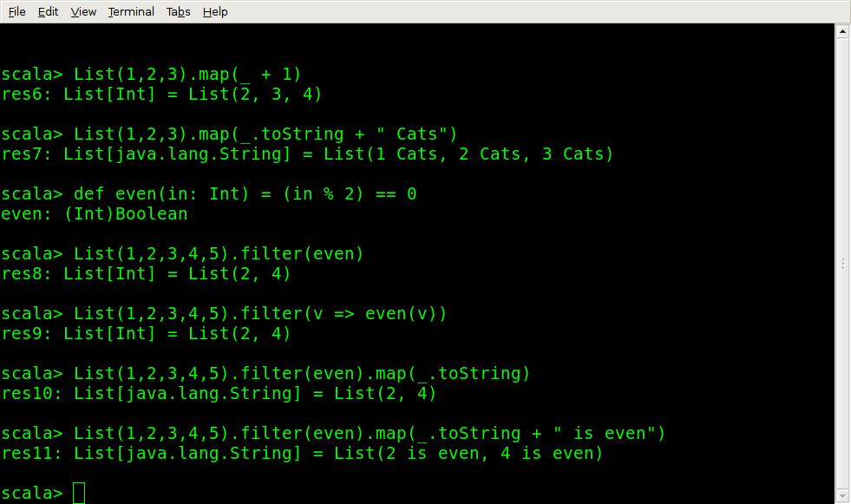
map & filter

Slide 9
flatMap
flatMap
  Flattens the collection the function returns
  Useful for nesting operations on collections
  "99 red balloons".toList
  List[Char] = List(9, 9, , r, e,...)
  List("99 red balloons", "88 lines", "44 women").
  flatMap(s => s.filter(Character.isDigit))
  List[Char] = List(9, 9, 8, 8, 4, 4)

Slide 10
foldLeft & reduceLeft
Perform an operation on adjacent members of a collection
Good for: sum, product, etc.
List(1,2,3,4).reduceLeft(_ + _)
Int = 10
def sq(in: Int) = in * in
def sum(in: List[Int]) = in.foldLeft(0)(_ + _)
def sumSq(in: List[Int]) = sum(in.map(sq))
def sqSum(in: List[Int]) = sq(sum(in))

Slide 11
Parser Calculator
object Calc extends JavaTokenParsers {
def expr = term ~ rep("+" ~ term | "-" ~ term)
def term = factor ~ rep("*" ~ factor | "/" ~ factor)
def factor = floatingPointNumber | "(" ~ expr ~ ")"
}

Slide 12
Parser Calculator
import scala.util.parsing.combinator._
object Calc extends JavaTokenParsers {
def expr = term ~ rep("+" ~ term | "-" ~ term) ^^ {
case v ~ f => f.foldLeft(v) {
case (x, "+" ~ term) => x + term
case (x, "-" ~ term) => x – term }}
def term = factor ~ rep("*"~factor | "/"~factor) ^^ {
case v ~ f => f.foldLeft(v) {
case (x, "*" ~ term) => x * term
case (x, "/" ~ term) => x / term }}
def factor: Parser[Double] =
(floatingPointNumber ^^ (_.toDouble)) |
"(" ~> expr <~ ")"
}

Slide 13
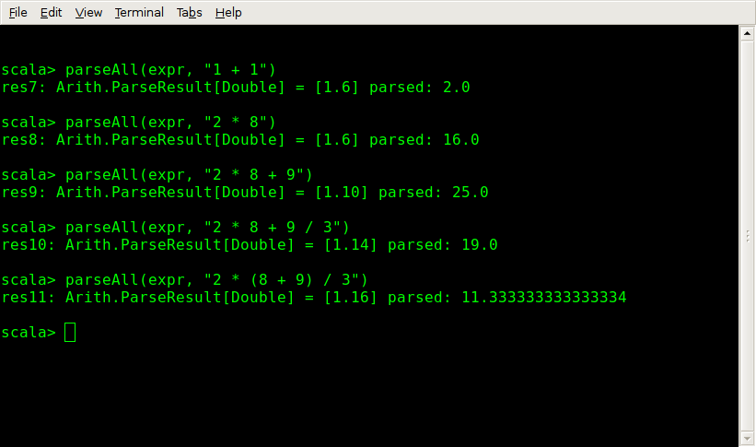
Calculator in Action

Slide 14
Scala: Functions are Objects
Objects can be passed as parameters
Functions are syntactically easy to create
var name = “”
SHtml.text(name, name = _)
They bind to variables/values (e.g. name)

Slide 15
Partial Functions
PartialFunction[A,B] extends Function1[A,B]
isDefinedAt(x: A)
Better known as pattern matching:
{
case Foo(bar) => bar
case Baz(dog) => dog
}

Slide 16
Composing Partial Function
{ case Foo(bar) => bar
case Baz(dog) => dog
} orElse { // compose
case Moo(cow) => cow
case Meow(cat) => cat
}

Slide 17
Extractors and Guards
Extract data while matching other parts in a pattern:
{ case “Foo” :: id :: Nil => doIt(id) }
Guards:
{ case “Foo” :: id :: Nil
if isValid(id) && loggedIn_? =>
doIt(id) }

Slide 18
Remembering Functions
Functions are Objects
Map[String, String => XML]
Map[String, PartialFunction[String, XML]]
GET /ajax?OPAQUE_ID=someValue
Map[OPAQUE_ID](someValue)

Slide 19
XML literals and manipulation
In Scala, XML is like String: supported at the language level and immutable
<foo>{(1 to 10).
map(i => <val>{i}</val>)}</foo>
(xml \ “val”).map(_.text.toInt).
.foldLeft(0)(_ + _) == 55

Slide 20
Actors and Partial Functions
Threadless, stackless units of execution
React to events and otherwise consume nothing but memory
react(PartialFunction[Any, Any]) →
react {case Foo(bar) => doSomething(bar)
case Baz(dog) =>
doElse(dog) }
react(primaryHndlr orElse secondaryHndler)

Slide 21
Lift REST APIs
LiftRules.addDispatchBefore {
case RequestMatcher(
RequestState(
"showstates":: xs, _),_) =>
XmlServer.showStates(xs) }
def showStates(...) = XmlResponse(
<states renderedAt={timeNow.toString}>
... </states>)

Slide 22
Lift and HTML forms
var name = “”
text(name, name = _)
def setLocale(loc: String) ...
select(Locale.getAvailableLocales.toList.
map(lo => (lo.toString, lo.getDisplayName)),
setLocale)

Slide 23
Lift & AJAX
AJAX elements are bound to functions:
a(() => {cnt = cnt + 1; SetHtml("cnt_id", Text( cnt.toString))}, “click me”)
ajaxSelect(opts,
v => DisplayMessage("You selected "+v))

Slide 24
Lift CometActors
Lift deals with all the plumbing:
def render = bind("time" -> timeSpan)
override def lowPriority = {
case Tick => reRender(false)
}

